Slide 1
JUST DO IT #5 9/14
Using page 25 in your book, draw the following rivers onto your blank world map:
Nile River
Indus River
Huang He(Yellow) River
Tigris River
Euphrates River

Slide 2
JUST DO IT #2 9/13
Create a list of 3 advantages and 3 disadvantages that come with living near a river.

Slide 3
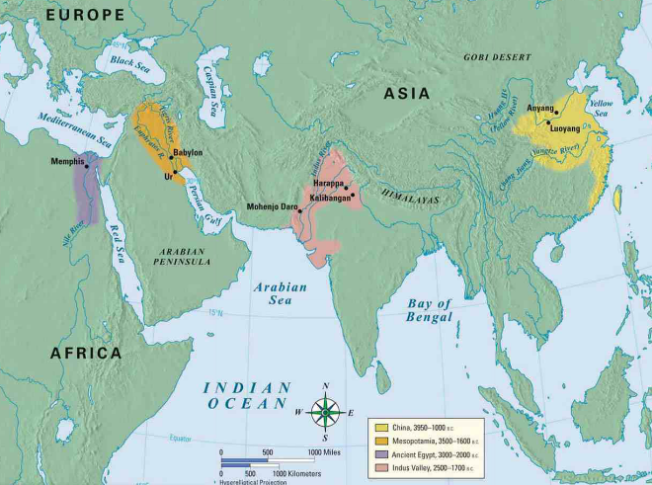
River valley Civilizations 3500-500 B.C.
WHI 3a

Slide 4
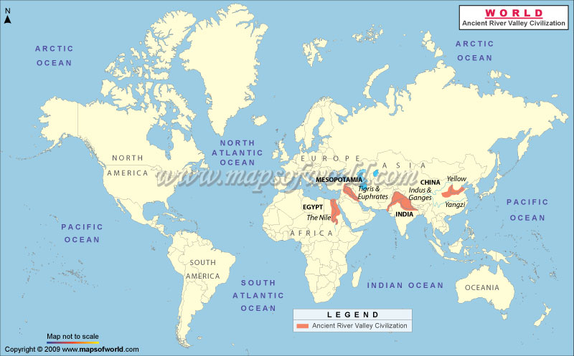
RIVER VALLEY CIVILIZATIONS
first permanent settlements created during the Neolithic Era (New Stone Age)
rivers provided settlements with access to water, fertile soil for crops, and protection from enemies(nomadic people)

Slide 5
JUST DO IT #1 2/12
Match each characteristic with one of the following civilizations: Mesopotamia, Egypt, India, China
Nile River -Hinduism
Tigris River -Mohenjo-Daro
Euphrates River -Confucianism
Huang He River -Polytheism
Pharaohs -Taoism
Cuneiform -Harappan
Hieroglyphics -Fertile Crescent

Slide 6
RIVER VALLEY CIVILIZATIONS
There are four major ancient river valley civilizations:
-Mesopotamia (Tigris and Euphrates River Valleys)
-Egypt (Nile River Valley & Nile Delta)
-India (Indus River Valley)
-China (Huang He River Valley)

Slide 7
RIVER VALLEY CIVILIZATIONS
Rivers offer rich soil and irrigation water for agriculture
Also in locations easily protected from invasions by nomads
Known as the “Cradles of Civilization”

Slide 8
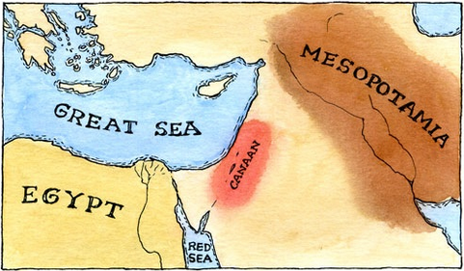
OTHER EARLY CIVILIZATIONS 2000-500 B.C.
Hebrews(Jews):
settled between the Mediterranean Sea and the Jordan River Valley (part of Fertile Crescent in Southwest Asia).

Slide 9
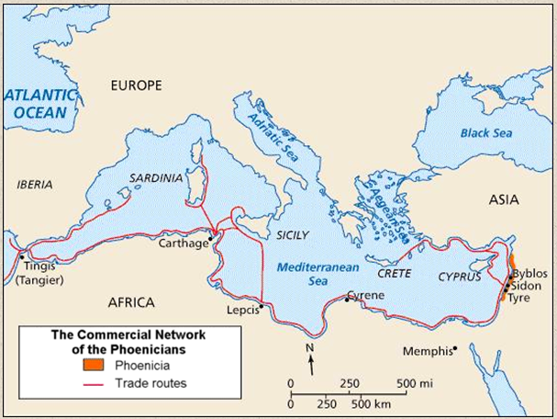
OTHER EARLY CIVILIZATIONS 2000-500 B.C.
Phoenicians:
settled along the Mediterranean coast (part of Fertile Crescent in Southwest Asia).

Slide 10
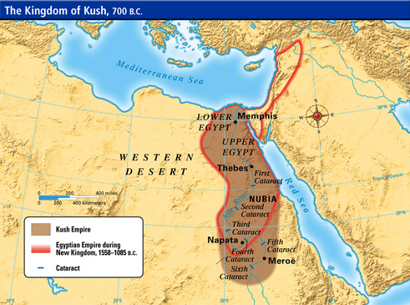
OTHER EARLY CIVILIZATIONS 2000-500 B.C.
Nubia:
a separate kingdom located on upper(southern) Nile River(Africa)

Slide 11
JUST DO IT #1 9/15
Read the scenario on page 26 and answer the question, “Does Mummar’s punishment fit the crime?” in a paragraph(3-5 sentences).

Slide 12
JUST DO IT #3 9/18
Examine the map on page 73 and answer questions #1-2

Slide 13
IN CLASS Assignment
Using the notes from 3b, organize the characteristics of river valleys into a mindmap for each of the following:
1. Social Patterns
2. Political Patterns
3. Economic Patterns

Slide 14
DEVELOPMENT OF PATTERNS IN RIVER VALLEYS
WHI 3b

Slide 15
Cradles of Civilization
Big Idea:
River valleys were the “Cradles of Civilization.” Early civilizations made major contributions to social, political, and economic progress.

Slide 16
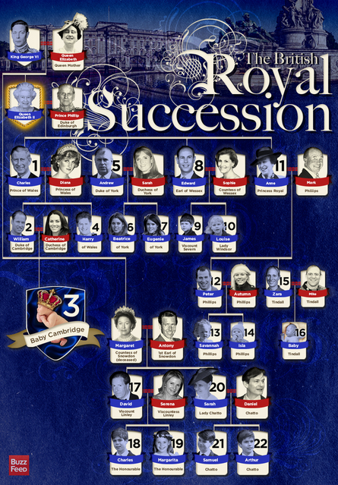
Social Patterns
Hereditary rulers: Dynasties of kings & pharaohs(Egypt)- based on family

Slide 17
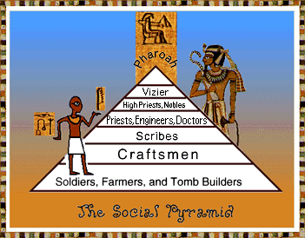
Social Patterns
Strict and rigid social class system
Government and priests on top, slaves on the bottom
Slavery is accepted

Slide 18
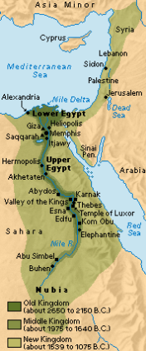
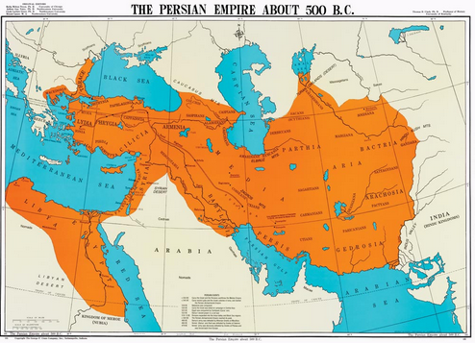
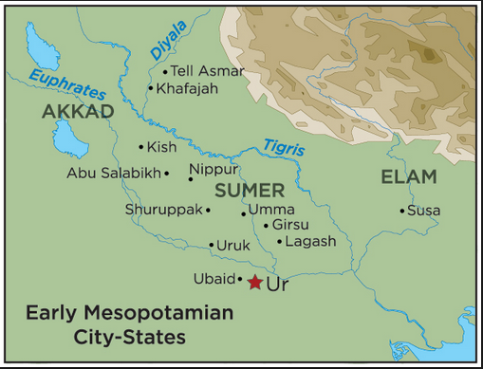
political patterns
World’s first organized governments (states)
First: City-States: a city that forms an independent state
Next: Kingdom: a large state under control of a leader
Finally: Empire: a group of states under the control of one leader

Slide 19
political patterns
Centralized government
based on ultimate & religious authority
Ex: Egypt’s Pharaoh

Slide 20
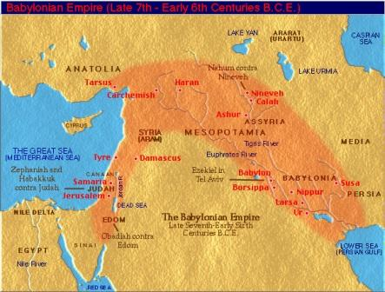
political patterns
Hammurabi & his code:
Babylon run by a ruler named Hammurabi
Established world’s first written law
“eye for an eye” principle

Slide 21
Some of Hammurabi’s Laws
If a man puts out the eye of a patrician, his eye shall be put out.
If a man knocks the teeth out of another man, his own teeth will be knocked out.
If a son strikes his father, his hands shall be hewn off.
If a freeborn man strikes the body of another freeborn man of equal rank, he shall pay one gold mina.
If the slave of a freed man strikes the body of a freed man, his ear shall be cut off.

Slide 22
political patterns
The Ten Commandments:
Basis of civil and religious law for Hebrews
New Covenant(deal) with God
Hebrews obey the Ten Commandments, God protects Hebrews

Slide 24
In Class Assignment
Using page 32 and your Ipad, create a poster for Hammurabi’s Code of Law that illustrates at least 5 of his laws. You can use colored pencils to make it more creative.

Slide 25
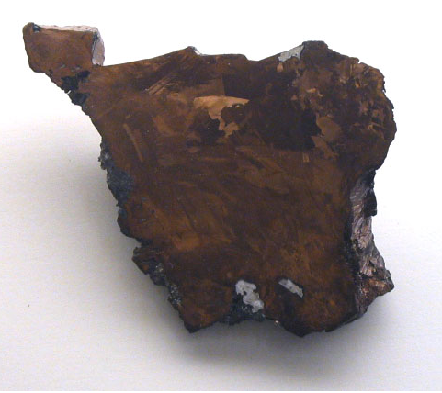
Economic patterns
Once man moved away from making his tools with stone, he turned to metal
Iron and bronze were used in the first metal tools and weapons

Slide 26
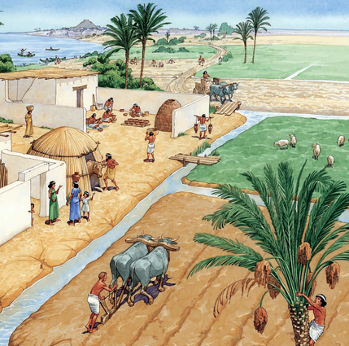
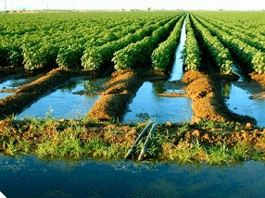
Economic patterns
Better tools, farm equipment like plows, and irrigation all led to more productive farms
created a larger food source(agricultural surplus)
Began to increase human population

Slide 27
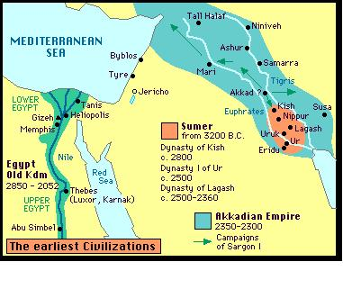
Economic patterns
First cities developed:
Within Mesopotamia lies a region called Sumer
Large ancient cities in Sumer include Ur, Uruk and Nippur

Slide 28
Economic patterns
Slavery:
Ancient slavery was common and accepted
It is NOT based on race
The losing soldiers of war were taken as slaves

Slide 29
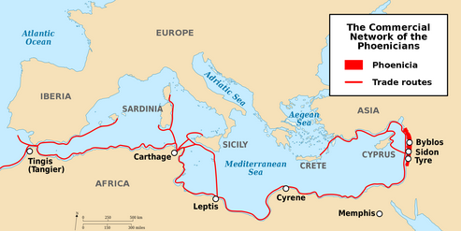
Economic patterns
Sea Trade:
Man branches out and begin to trade over rivers
The Phoenicians set up a vast trading empire all around the Mediterranean Sea

