Slide 1
JUST DO IT #3 9/18
Examine the map on page 73 and answer questions #1-2

Slide 2
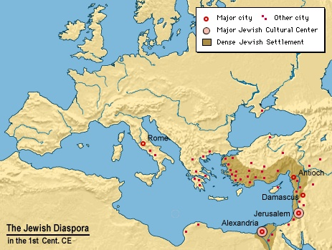
Religious Traditions & Judaism
WHI 3cd

Slide 3
RELIGIOUS TRADITIONS
Polytheism:
Belief in more than 1 God
Practiced by most early
Civilizations
(Egyptians, Greeks, Romans, Mayans, Aztecs)
Monotheism:
Belief in 1 God
Practiced by the Hebrews(Jews)

Slide 4
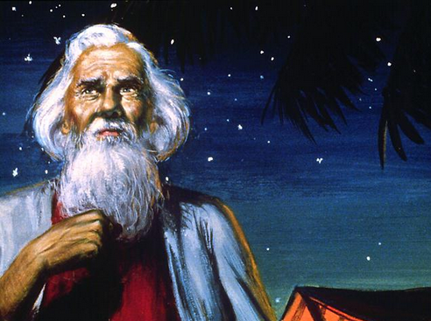
JUDAISM
As the first monotheistic religion, Judaism came as a M.A.J.O.R. shock to the world
Moses led the Jews out of Egypt
Abraham was the founder of Judaism
made covenant with God

Slide 5
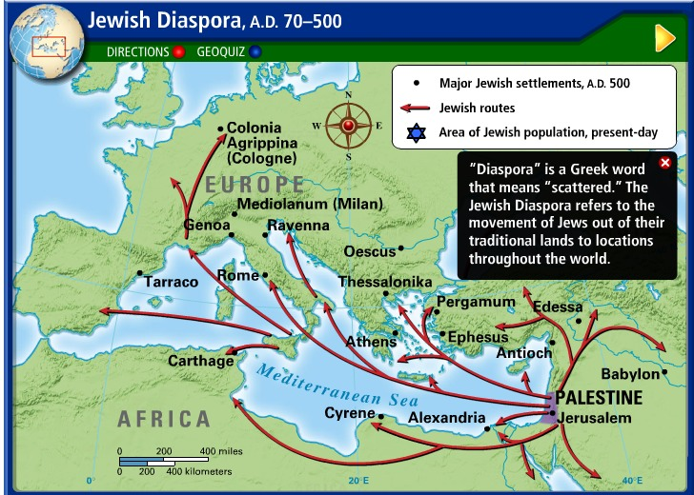
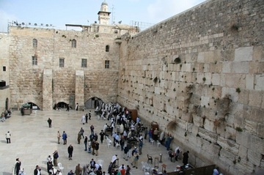
JUDAISM
Jerusalem became holy city
Home of the Western Wall
Out of Israel & into Babylon the Jews dispersed(Exiled)
Known as the Diaspora

Slide 6
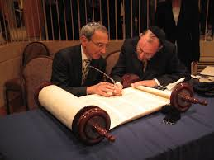
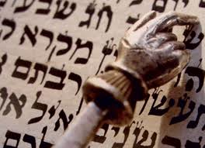
JUDAISM
Religious & moral conduct came from the Torah
Contains written records & beliefs of the Jews
Contains the Ten Commandments

