Slide 1
JUST DO IT #3 2/19
Answer the following questions using the map on page 94.
1. Which Persian emperor had the biggest empire?
2. What bodies of water might the Persian empire have had control over?
3. Which continents did the Persian empire expand into?
4. What 3 cities did the Royal Road connect?
5. What was the Persian empire’s farthest extent west?
6. What physical feature might have prevented the Persian empire from extending farther east?

Slide 2
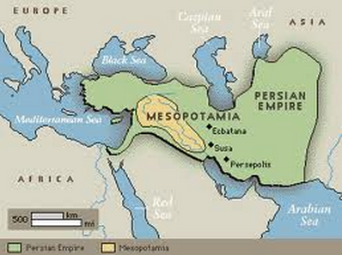
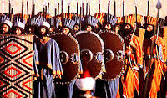
Persian Empire
WHI 4A

Slide 3
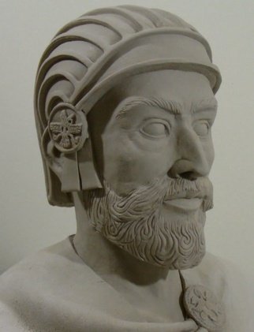
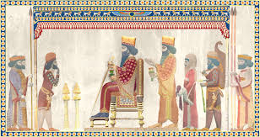
PERSIAN EMPIRE
The Persian Empire ruled through the eye of the T.I.G.E.R.
Tolerance(acceptance) of conquered people
Allowed those conquered to keep their customs & religions

Slide 4
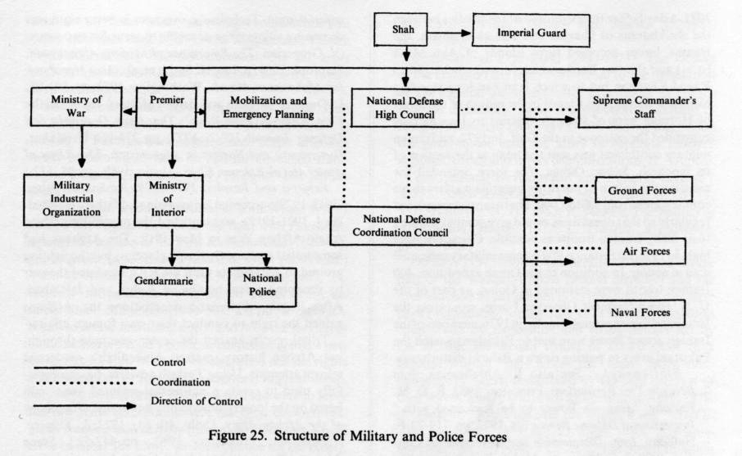
PERSIAN EMPIRE
Imperial bureaucracy
Darius divided Persia into provinces(states) ruled by governors called Satraps
Each Satrap collected taxes for the emperor

Slide 5
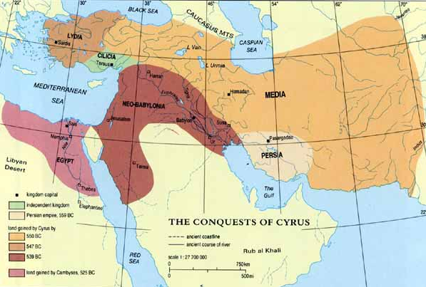
PERSIAN EMPIRE
Geography of Persia
rested upon earlier Central Asian & Mesopotamian civilizations
Became the largest empire in the world

Slide 6
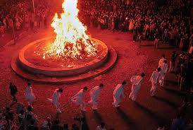
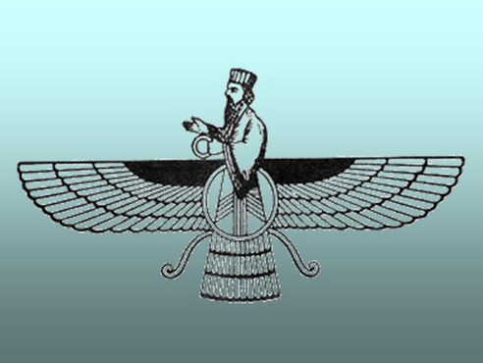
PERSIAN EMPIRE
Establishment of Zoroastrianism(religion)
Believed in 2 opposing forces of the universe
Good vs evil

Slide 7
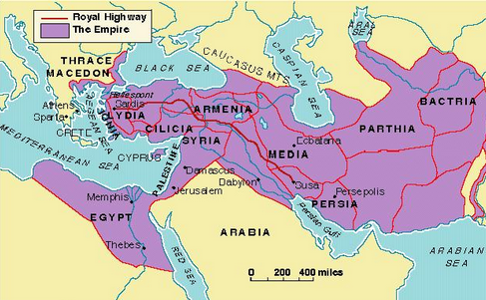
PERSIAN EMPIRE
Royal road system
constructed under Emperor Darius I
traveled through the entire empire

Slide 8
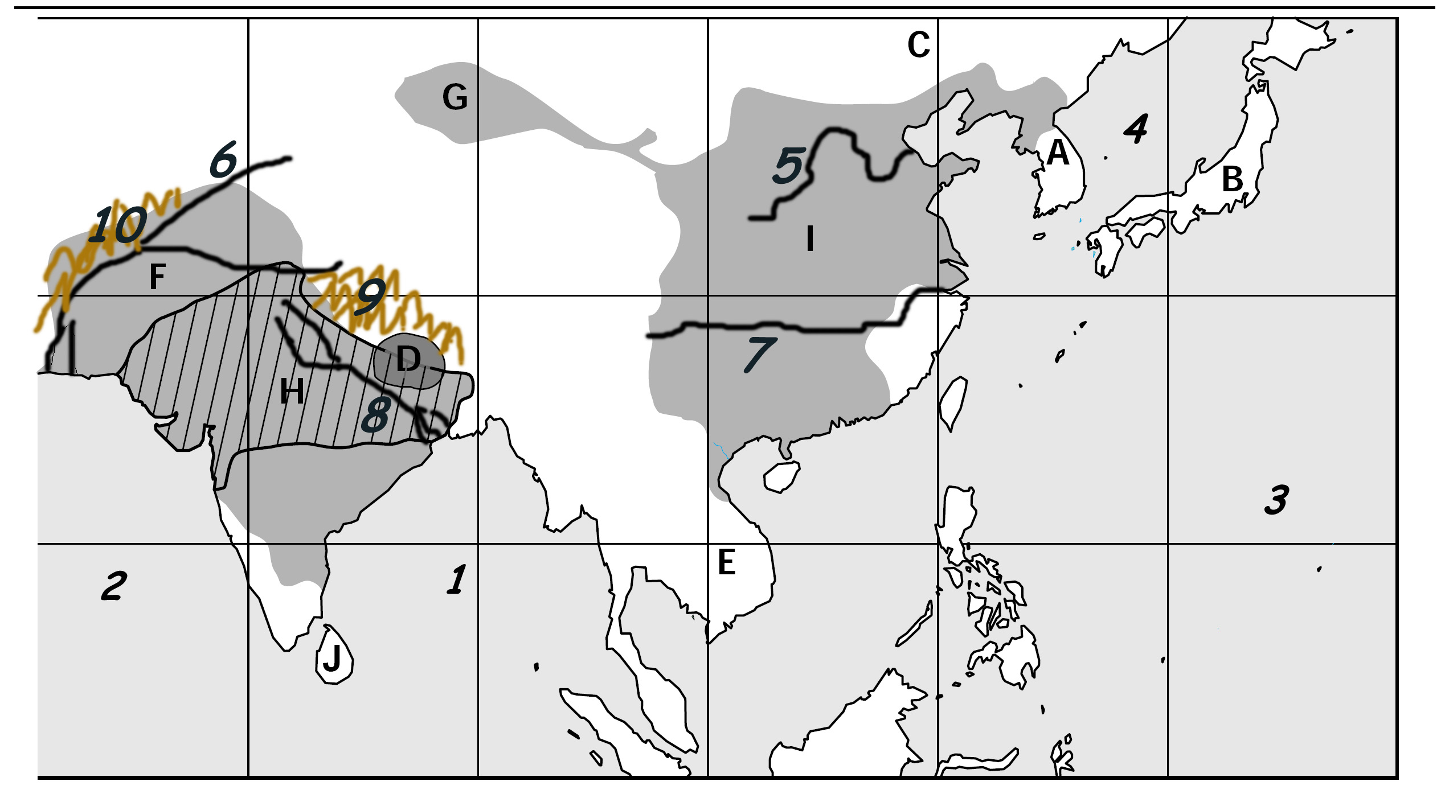
Map Assignment
Locate & Label:
India(p.42):
Himalayan Mts.
Hindu Kush Mts.
Indus River
Ganges River
Indian Ocean
Arabian Sea
China(p.100):
Huang He River
Yangtze River
Korea
East China Sea
Gobi Desert
Pacific Ocean
Japan

