Slide 1
JUST DO IT #4 2/22
Read the scenario on page 56 and answer the question, “Will you stay or flee?” in a paragraph that is 3-5 sentences long.

Slide 2
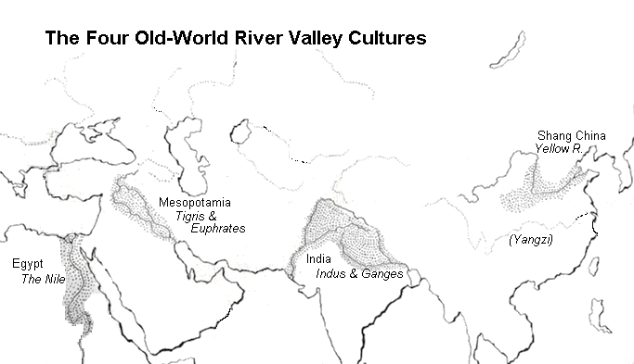
WHI 4b Part I
The India Subcontinent

Slide 3
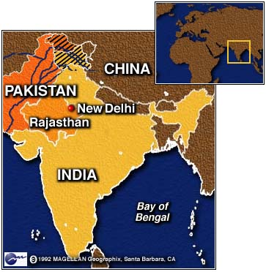
India
India is considered a subcontinent of Asia

Slide 4
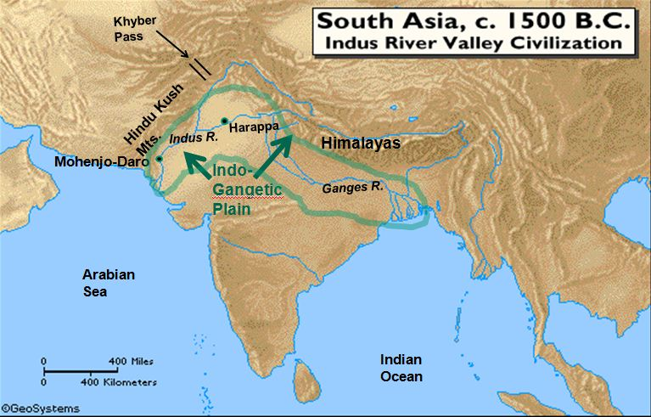
India
The first civilizations within ancient India sprang up along the Indus River Valley
Later, civilization spread to the Ganges River Valley

Slide 5
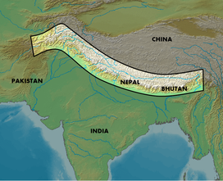
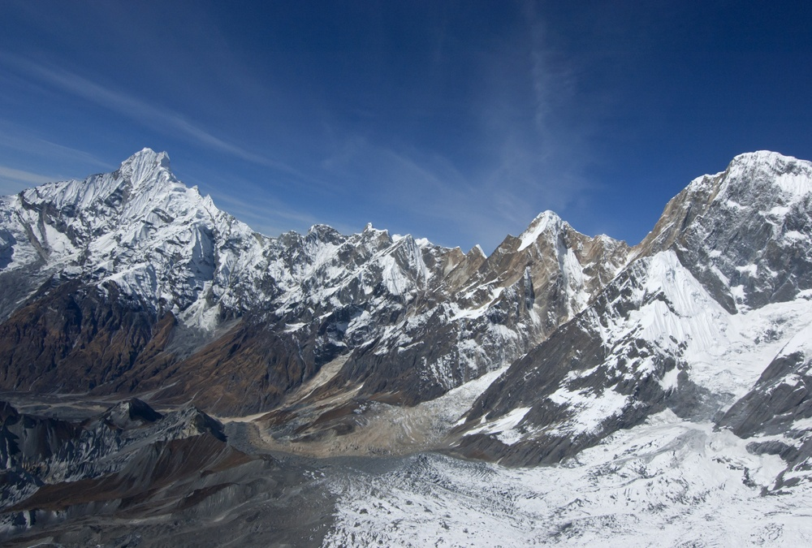
India
physical barriers made invasion difficult
Mountains to the north
Himalayas and the Hindu Kush
Surrounded on three sides by the Indian Ocean

Slide 6
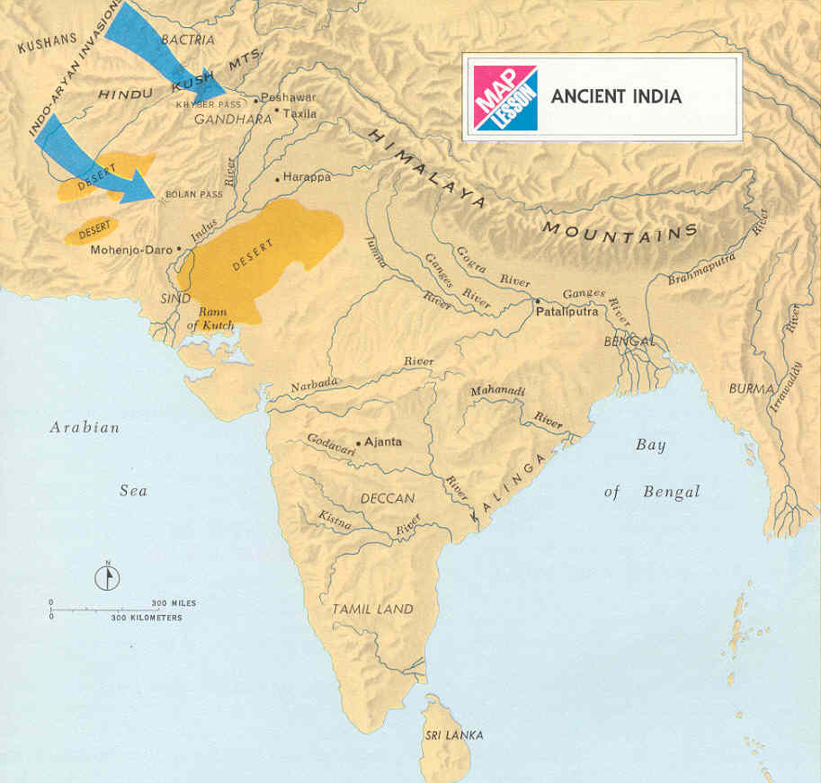
India
People migrated(moved) into the India subcontinent by using mountain passes in the Hindu Kush mountains

Slide 7
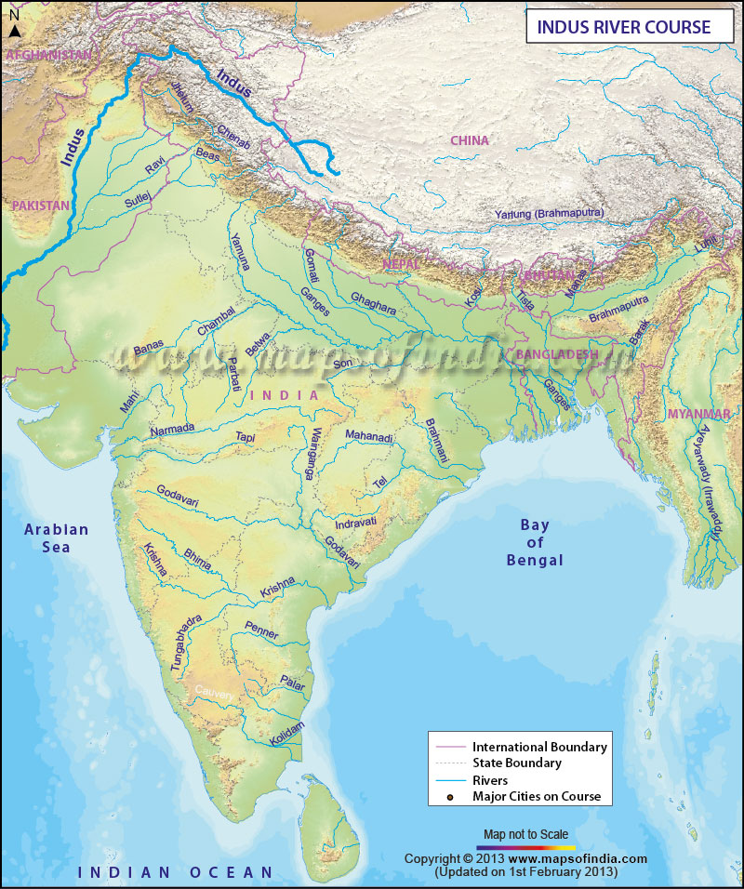
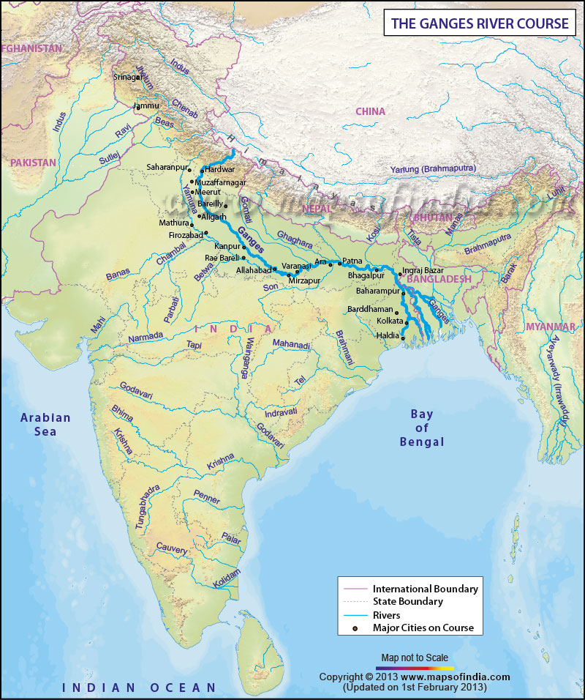
INDIA
India’s two main rivers are the Indus River and the Ganges Rivers
The Indus River
The Ganges River

Slide 8
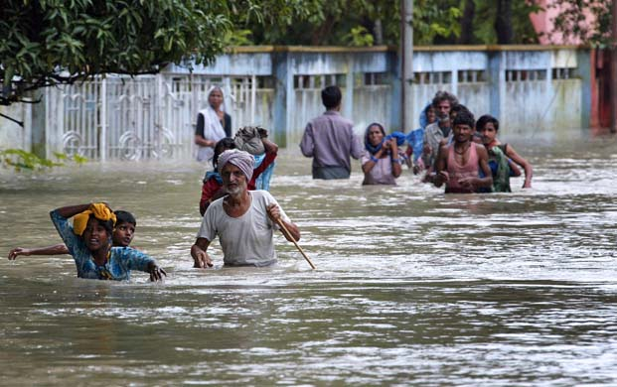
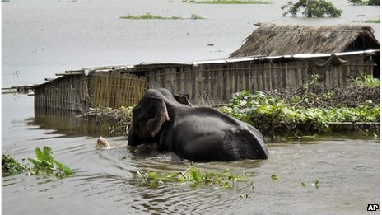
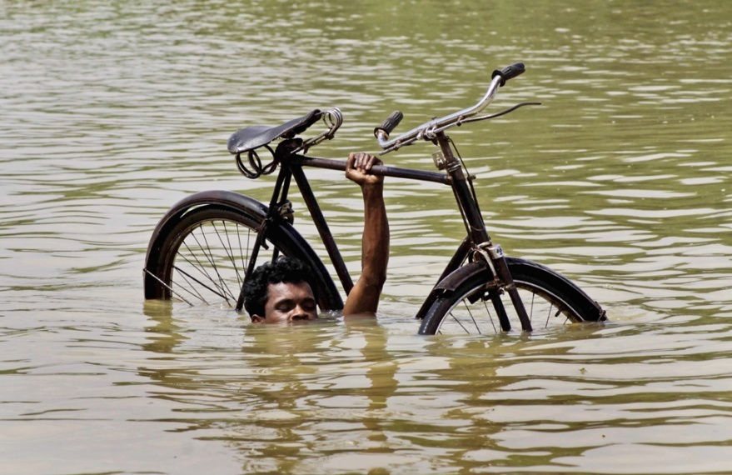
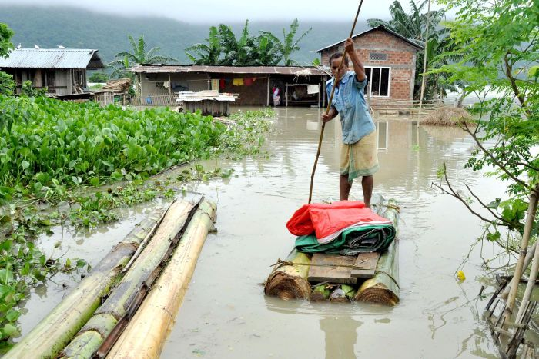
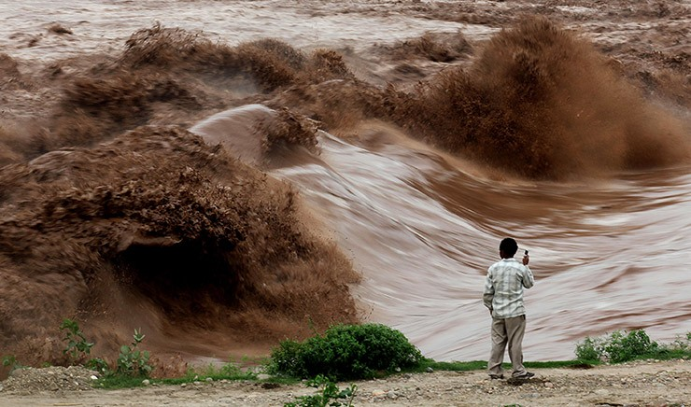
India
Both rivers flooded and provided good soil for farming

Slide 9
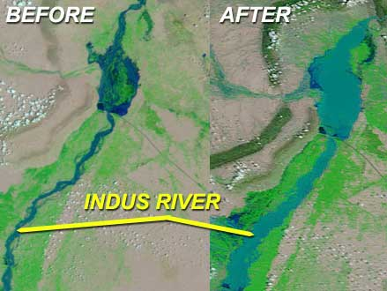
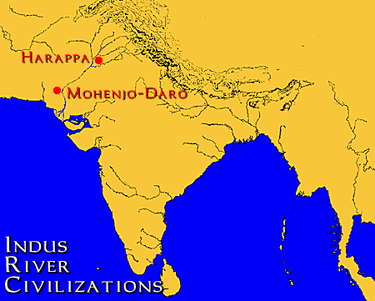
INDUS RIVER VALLEY CIVILIZATIONS
By 2500 B.C., the first major cities in India were being built
two largest cities along the Indus River were
Harappa
Mohenjo-Daro

Slide 10
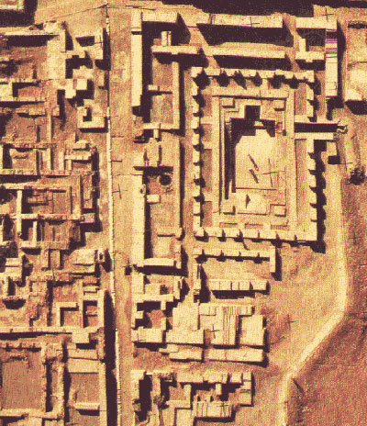
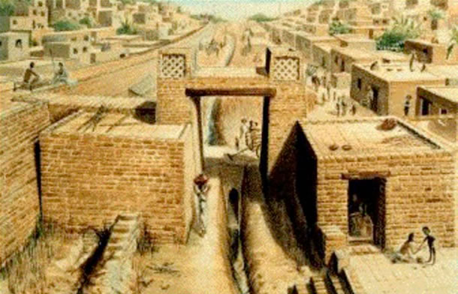
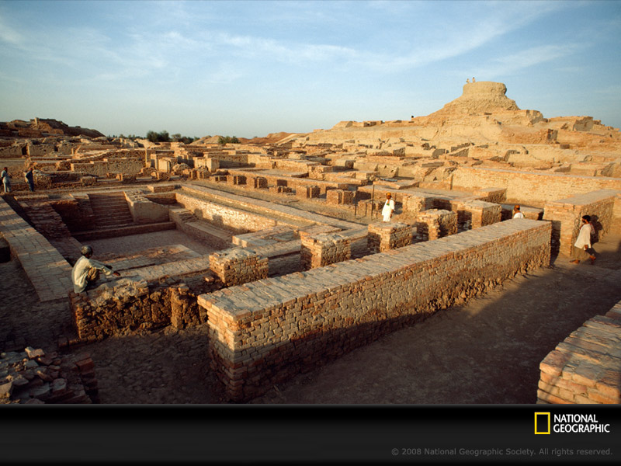
INDUS RIVER VALLEY CIVILIZATIONS
Harappa & Mohenjo-Daro came at no L.O.S.S.
Large, well-planned cities
Oven-baked bricks were used to make buildings
Streets and buildings laid out in a grid
Sophisticated plumbing and sewage system within the city

Slide 11
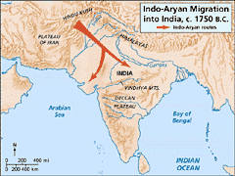
ARYANS (INDO-ARYANS)
the Aryans crossed the Hindu Kush and migrated into India
Aryans began to dominate the people in India

Slide 12
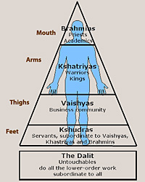
ARYANS (INDO-ARYANS)
Installed a caste system dividing people into classes
Influenced all social interactions & choices of occupation

Slide 13
ARYANS (INDO-ARYANS)
Brahmins- Priests
Kshatryias- Warriors
Vaishyas- Merchants
Sudras- Peasants
Untouchables- Out of caste system

Slide 14
JUST DO IT #5 2/23
Answer the following questions using your notes from 4b India:
1. What 2 river valleys developed what is now known as India?
2. What 2 mountain ranges form India’s northeast and northwest borders?
3. What 2 rivers flow through India?
4. What is a major problem with these rivers?
5. What were 2 of India’s earliest cities?
6. What type of system did the Indo-Aryans establish in India?

Slide 15
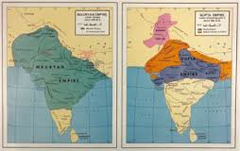
WHI 4b Part II
Indian Empires

Slide 16
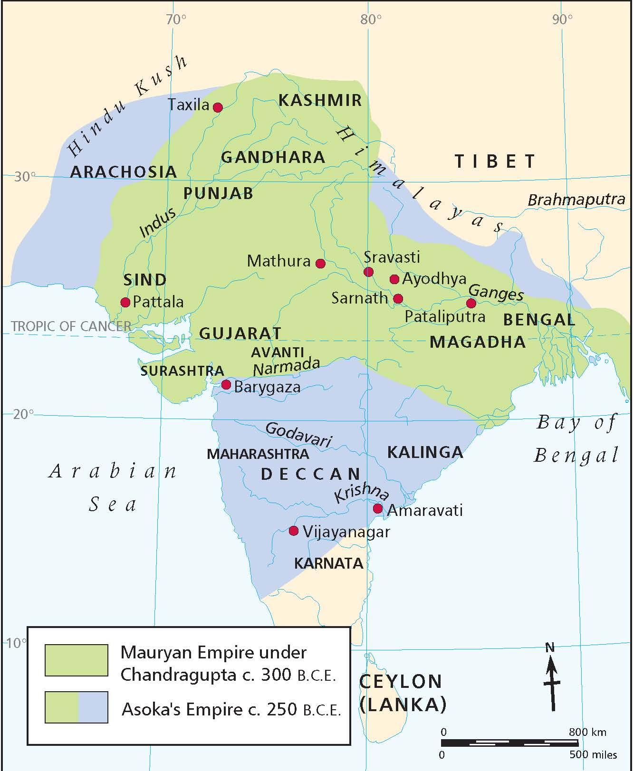
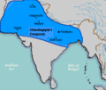
The Mauryan Empire
Chandragupta Maurya set up the Mauryan Empire across northern India
Maurya’s grandson, Asoka S.P.R.E.A.D. the Mauryan Empire to its biggest extent and power

Slide 17
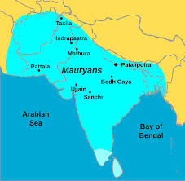
The Mauryan Empire
Spread Buddhism from India to China & Southeast Asia via missionaries
Provided free hospitals to citizens
Roads were built

Slide 18
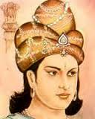
The Mauryan Empire
Extended the political unification of India
Asoka led the Mauryan Empire
Developed veterinary clinics

Slide 19
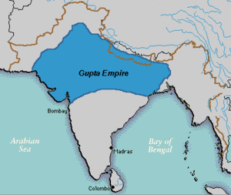
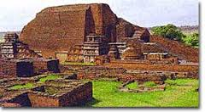
Gupta Empire
Chandra Gupta started a later empire in northern India: The Gupta Empire
The Gupta Empire was full of great M.A.T.E.R.I.A.L.

Slide 20
Gupta Empire
Mathematics
concept of zero
Astronomy
proved Earth was round
Textiles
silk and cloth

Slide 21
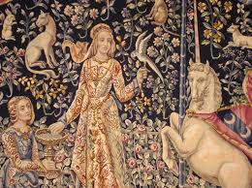
Gupta Empire
Era of the Golden Age of classical Indian culture
Religion was big on Buddhism
India became stronger under Gupta

Slide 22
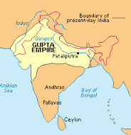
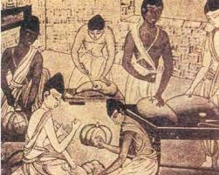
Gupta Empire
Advanced in medicine
set broken bones, nose surgery
Literature
Poetry, plays, dances

Slide 23
IN CLASS ASSIGNMENT
Create an advertisement/poster for either the Mauryan Empire, the Gupta Empire or the Persian Empire. Make sure it includes the following:
1 made up slogan for your empire
2 illustrations of different rulers from your empire
3 achievements of your empire(can be illustrations)
4 reasons why your empire is greater than all the others we have looked at so far

