Slide 1
Impacts of Military Conquests
WHI 6e

Slide 2
JUST DO IT #5 3/18
Match each item with one of the following:
1st Punic War, 2nd Punic War, 3rd Punic War
-Hannibal
-fought over Sicily
-Carthage burned to the ground
-fought in Rome
-Carthage crosses over Alps
-fought in Africa
-involved elephants
-resulted in the end of Carthage

Slide 3
JUST DO IT #1 3/21
Answer map questions #1-2 on page 149.

Slide 4
JUST DO IT #5 3/18
Match each item with one of the following:
1st Punic War, 2nd Punic War, 3rd Punic War
-Hannibal
-fought over Sicily
-Carthage burned to the ground
-fought in Rome
-Carthage crosses over Alps
-fought in Africa
-involved elephants
-resulted in the end of Carthage

Slide 5
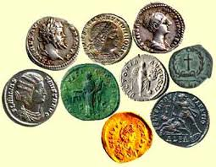
Military Conquests
The Roman Republic’s decline was caused
by a M.U.D. S.L.I.D.E.
-Migration of small farmers into cities
-Unemployment
-Devaluation of Roman currency(money)

Slide 6
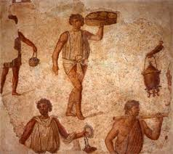
Military Conquests
-Spread of slavery in the agriculture system
-Land gained led to more problems
-Inflation

Slide 7
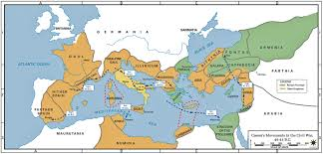
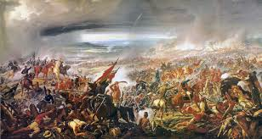
Military Conquests
-Division among leaders
-Eruption of Civil War over the power of Julius Caesar

Slide 8
Imperial Monarchs
WHI 6f

Slide 9
JUST DO IT #5 3/21
Match each item with one of the following:
1st Punic War, 2nd Punic War, 3rd Punic War
-Hannibal
-fought over Sicily
-Carthage burned to the ground
-fought in Rome
-Carthage crosses over Alps
-fought in Africa
-involved elephants
-resulted in the end of Carthage

Slide 10
IMPERIAL MONARCHS
-Rome became ruled by 3 men
(the 1st Triumvirate)
-Julius Caesar: Patrician Senator and general
-Crassus: rich Roman general
-Pompey: Roman general, frenemy to Caesar
Julius Caesar
Marcus Crassus
Gnaeus Pompey

Slide 11
IMPERIAL MONARCHS
-Crassus gets killed in battle
-Pompey flees from Caesar’s army & is killed in
Egypt by the Pharaoh
-Caesar seizes power as consul & dictator with
total control of Rome
Julius Caesar

Slide 12
IMPERIAL MONARCHS
Caesar’s rule as dictator was a G.R.A.V.E. concern
-Gave away land
-Reformed(changed) Rome’s debt
-Assassinated by his friends
-Vied for a new tax code
-Established a new calendar

Slide 13
IMPERIAL MONARCHS
-a small group of senators believed Caesar had too much power
-led by Brutus, the gang surrounds Caesar & stabs him to death(The Ides of March)

Slide 14
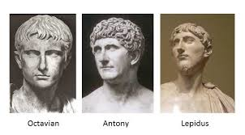
IMPERIAL MONARCHS
-following Caesar’s death, the 2nd Triumvirate formed
-Octavian: Caesar's grand-nephew and heir
-Marc Antony: Caesar's general
-Lepidus: friend of Caesar

Slide 15
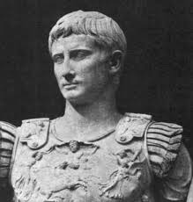
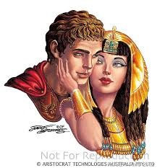
IMPERIAL MONARCHS
-Antony started seeing Cleopatra(Egyptian Pharaoh)
-Octavian convinced Rome’s Senate to declare war on Egypt leading to the Roman Civil War
-Octavian vs. Marc Antony & Cleopatra

Slide 16
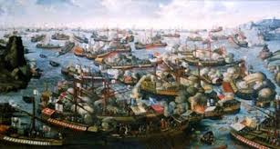
IMPERIAL MONARCHS
-Rome defeats Egypt at the Battle of Actium
-Antony & Cleopatra commit suicide
-Lepidus runs away
-Octavian declares himself Rome’s 1st Emperor & becomes Augustus Caesar

Slide 17
IN CLASS ASSIGNMENT
-Using pages 147-149 create a mindmap for each of the 6 leaders of Rome that took part in the triumvirates:
-Julius Caesar
-Crassus
-Pompey
-Marc Antony
-Octavian
-Lepidus

Slide 18
ROMAN EMPIRE
-The Roman Empire’s rise was anything but F.U.N.
-Failed to provide for a peaceful succession of Emperors
-Used imperial authority to unify Rome
-Needed the military to enlarge Rome

Slide 19
IN CLASS ASSIGNMENT
-Create 2 Diamond Poems using Rome and Carthage. Use your book and Ipad to research more information about each one in order to complete your poems.
Diamond Poem Format
ROME
VERB VERB
ADJECTIVE ADJECTIVE ADJECTIVE
NOUN NOUN NOUN NOUN
NOUN NOUN NOUN NOUN
ADJECTIVE ADJECTIVE ADJECTIVE
VERB VERB
CARTHAGE

