Slide 1
JUST DO IT #2 2/25
Using your Ipad and textbook, complete a Venn Diagram comparing Hinduism and Buddhism. Include at least 5 items in each section.
Hinduism Both Buddhism

Slide 2
JUST DO IT #5 10/1
Match each item with either Confucianism or Taoism:
Worship ancestors in after life
Live in harmony with nature
Respect for elders
Lao Zi
Code of politeness
Inner peace
Education
Civil Service System
Exercises humility
Simple life
Respect for ancestors

Slide 3
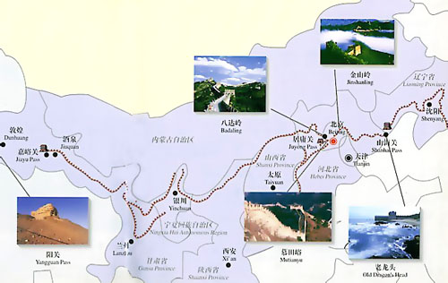
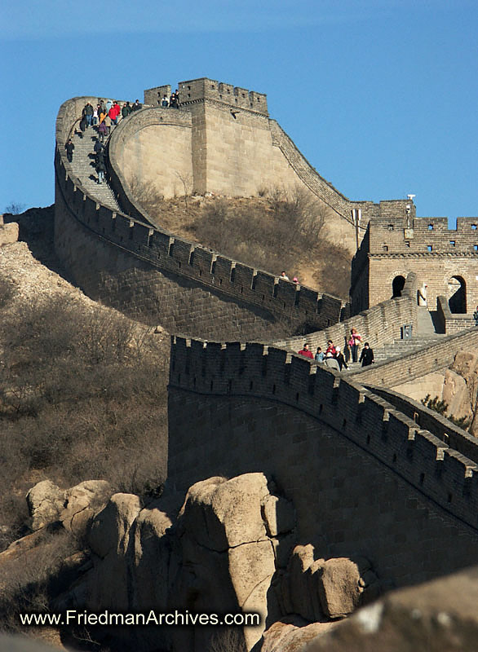
WHI.4E Chinese empire

Slide 4
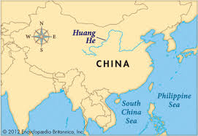
China’s geography
China was geographically isolated from most of the rest of the world
Centered on Huang He(Yellow River)

Slide 5
China’s Geography
China was occasionally invaded
Migratory invaders(Mongols) raided Chinese settlements from the north

Slide 6
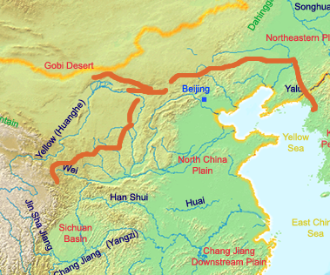
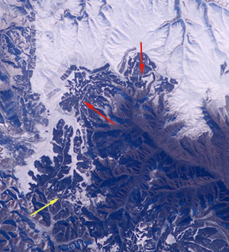
China’s Geography
Chinese emperor Qin Shi Huangdi constructed a large wall as a line of defense against invasions
one of the largest construction projects in human history

Slide 7
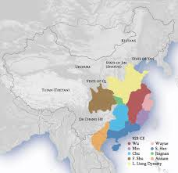
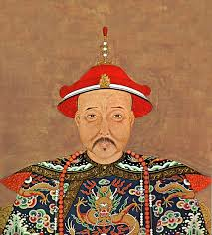
China’s Government
the Chinese developed a ruling structure with a succession(series) of ruling families, called dynasties
Chinese people obeyed their emperors because they were considered divine (God-like)

Slide 8
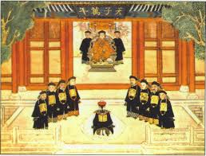
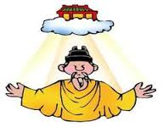
China’s Government
The rulers served under the Mandate of Heaven
emperors had God’s authority to rule as long as they were just (fair and good)
If the rulers became unjust (unfair and evil), the emperor would lose God’s approval and the people overthrew him

Slide 9
The Dynastic Cycle
New Ruler Gains the Mandate of Heaven
Dynasty founded by powerful leader
Period of Rebellion
Ruler loses the Mandate of Heaven
Period of Great Power and Prosperity
Golden Age
Period of Decline and Corruption

Slide 10
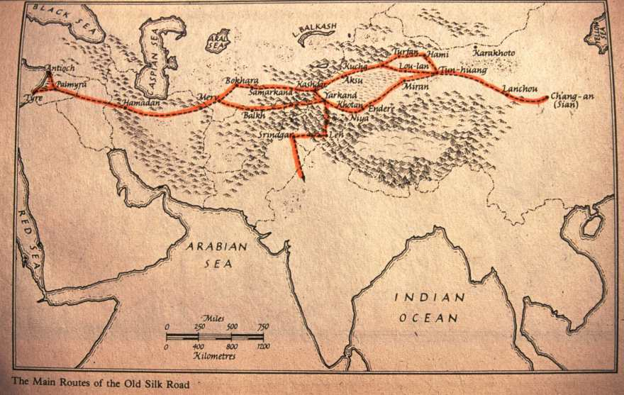
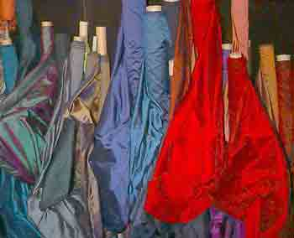
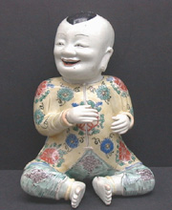
Silk road & trade
Silk Road facilitated trade & contact between China & other cultures as far away as Rome
Trade Products:
Paper
Porcelain
Silk

Slide 11
JUST DO IT #3 2/26
Answer the following questions in your book regarding the map:
Page 298 #1-2

Slide 12
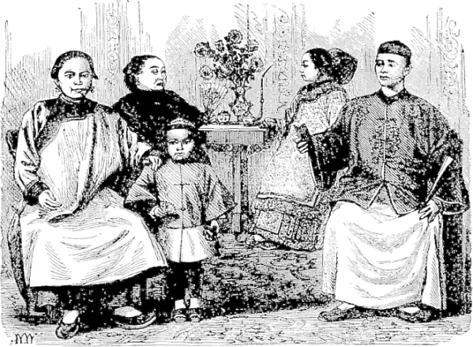
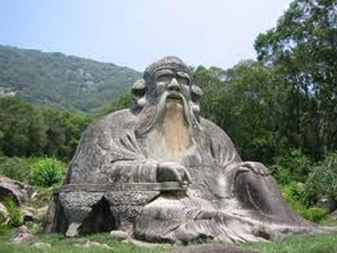
WHI.4f Chinese culture & Religion

Slide 13
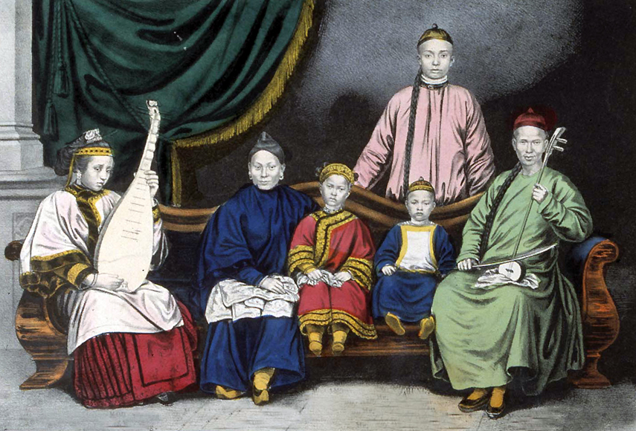
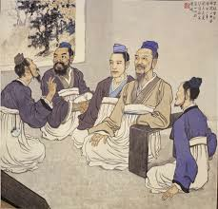
Confucianism
Confucianism is all about R.E.S.P.E.C.T.
Respect for elders
Emphasis on education

Slide 14
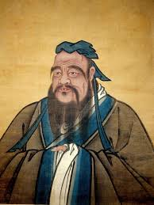
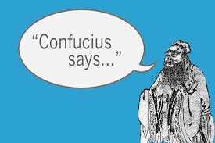
Confucianism
Social order formed in China
5 relationships: ruler and subject, father and son, husband and wife, older and younger brothers, and friend and friend
Popular belief humans are good, not bad

Slide 15
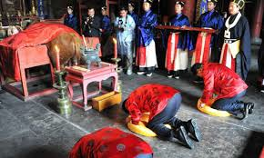
Confucianism
Even created a Code of Politeness
still in use within Chinese society today
Civil Service System
Created merit-based government jobs
Taught to worship ancestors in the afterlife

Slide 16
Taoism (Daoism)
Lao Zi was interested in finding a way to live in harmony with nature and find inner peace
Taoism leads “the Way” to living good L.I.V.E.S.

Slide 17
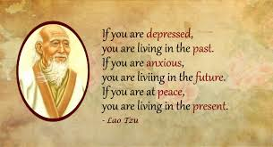
Taoism (Daoism)
Live in harmony with nature
Inner peace
Values & culture formed in China
Exercises humility in all things
Simple life is key

Slide 18
Yin and Yang
Found in both Confucianism and Taoism
two opposite powers which balance out the universe

Slide 19
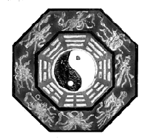
Yin and Yang
If you can balance these forces in your own life, you can reach harmony
Yin is the darker element
Yang is the brighter element;
These are complementary opposites

Slide 20
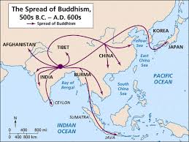
BUDDHISM
Chinese forms of Buddhism spread throughout Asia

Slide 21
In class assignment
Create a mind map of the following religions showing their characteristics that we have discussed in SOLs 3 & 4:
Judaism
Zoroastrianism
Hinduism
Buddhism
Confucianism
Taoism

